Slide 1

The Meta Vision: Connecting the World
Meta, formerly known as Facebook, envisions a future where people are connected through a shared virtual space. This shared space, known as the metaverse, will be a collective and immersive experience accessible to everyone.

Slide 2


What is Meta (Facebook)?
Social Media Giant
Technology Innovator
Meta is best known for its social media platforms, including Facebook, Instagram, WhatsApp, and Messenger. They connect billions of users worldwide.
Meta invests heavily in research and development of cutting-edge technologies, including artificial intelligence, virtual reality, and augmented reality.

Slide 3

The Rise of the Metaverse
1
Early VR and AR
The metaverse is built upon decades of research and development in virtual reality and augmented reality technologies.
2
The Gaming Boom
Gaming platforms like Fortnite and Roblox demonstrate the potential for shared online worlds with immersive experiences.
3
Meta's Vision
Meta is accelerating the development of the metaverse with its investments in VR headsets and software.

Slide 4

The Road Ahead: Meta's Metaverse Strategy
VR Hardware
Open Metaverse
Community Building
Meta is developing advanced VR headsets to provide immersive experiences in the metaverse.
Meta aims to create an open and interoperable metaverse, allowing users to move freely between different virtual worlds.
Meta is investing in tools and platforms to encourage collaboration and community building in the metaverse.

Slide 5
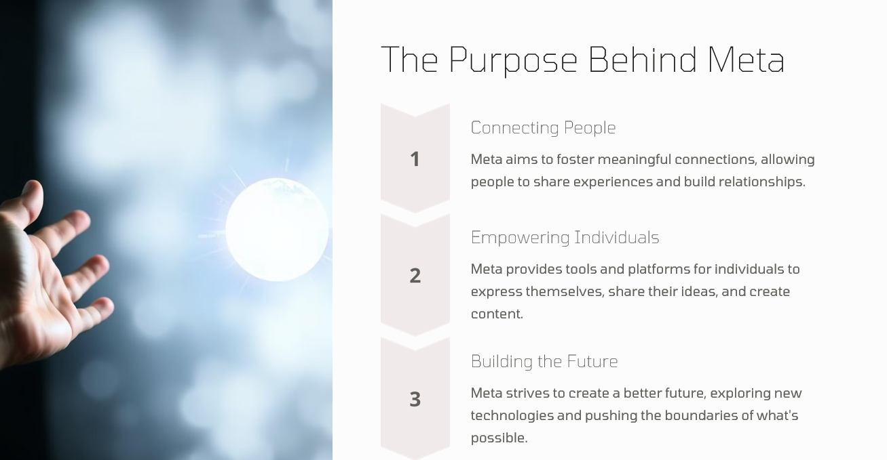

Slide 6
Key Technologies Powering the Metaverse
Virtual Reality (VR)
Augmented Reality (AR)
Artificial Intelligence (AI)
VR headsets provide immersive experiences by creating virtual environments.
AR overlays digital content onto the real world through devices like smartphones or smart glasses.
AI powers intelligent agents, personalized experiences, and natural interactions within the metaverse.

Slide 7
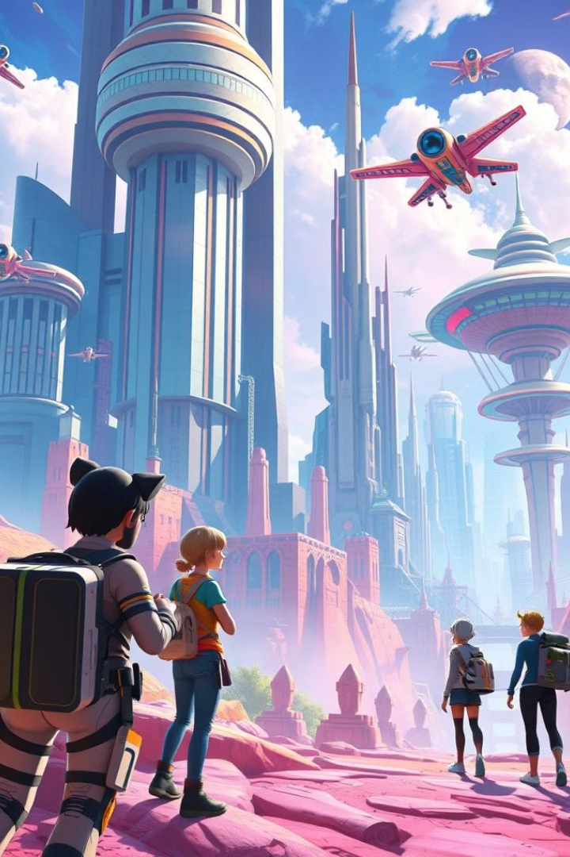



Immersive User Experiences
Personalized Avatars
Users create representations of themselves in the metaverse, allowing for self-expression and individuality.
Interactive Environments
The metaverse offers interactive experiences, allowing users to explore, play, and engage with virtual worlds.
Social Connections
The metaverse fosters new forms of social interaction, connecting people across physical boundaries.

Slide 8
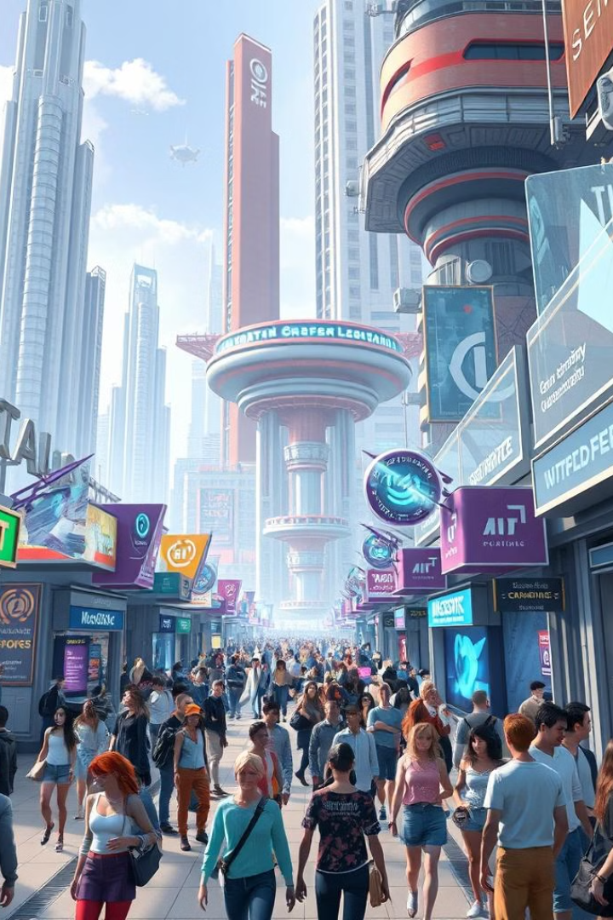
The Business Opportunities in the Metaverse
1
Virtual Commerce
2
Virtual Events
The metaverse opens up new avenues for online shopping, virtual goods, and digital services.
Companies can host immersive events, conferences, and concerts in virtual spaces.
3
New Business Models
The metaverse creates opportunities for innovative business models and revenue streams.

Slide 9




Metaverse and the Future of Social Interaction
Shared Experiences
New Communities
Evolving Social Norms
The metaverse allows people to share experiences together, regardless of their physical location.
The metaverse creates opportunities for forming new connections and building online communities.
The metaverse will likely shape new social norms and etiquette for interacting in virtual spaces.

Slide 10
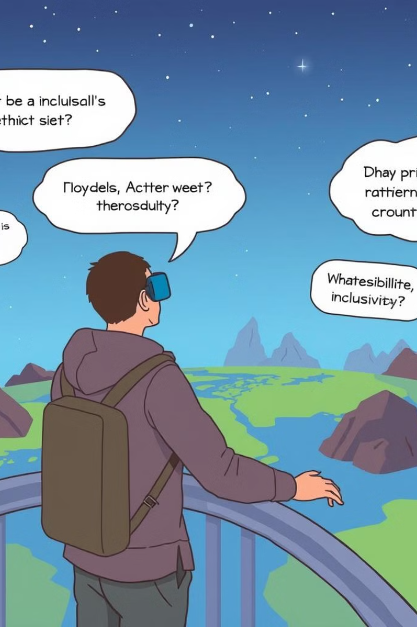
Ethical Considerations in the Metaverse
Data Privacy
How will user data be collected, stored, and used in the metaverse?
Digital Identity
How will identity and authentication be managed in the metaverse to ensure security and trust?
Accessibility
Will the metaverse be accessible to all users, regardless of their physical abilities or technological resources?

Slide 11
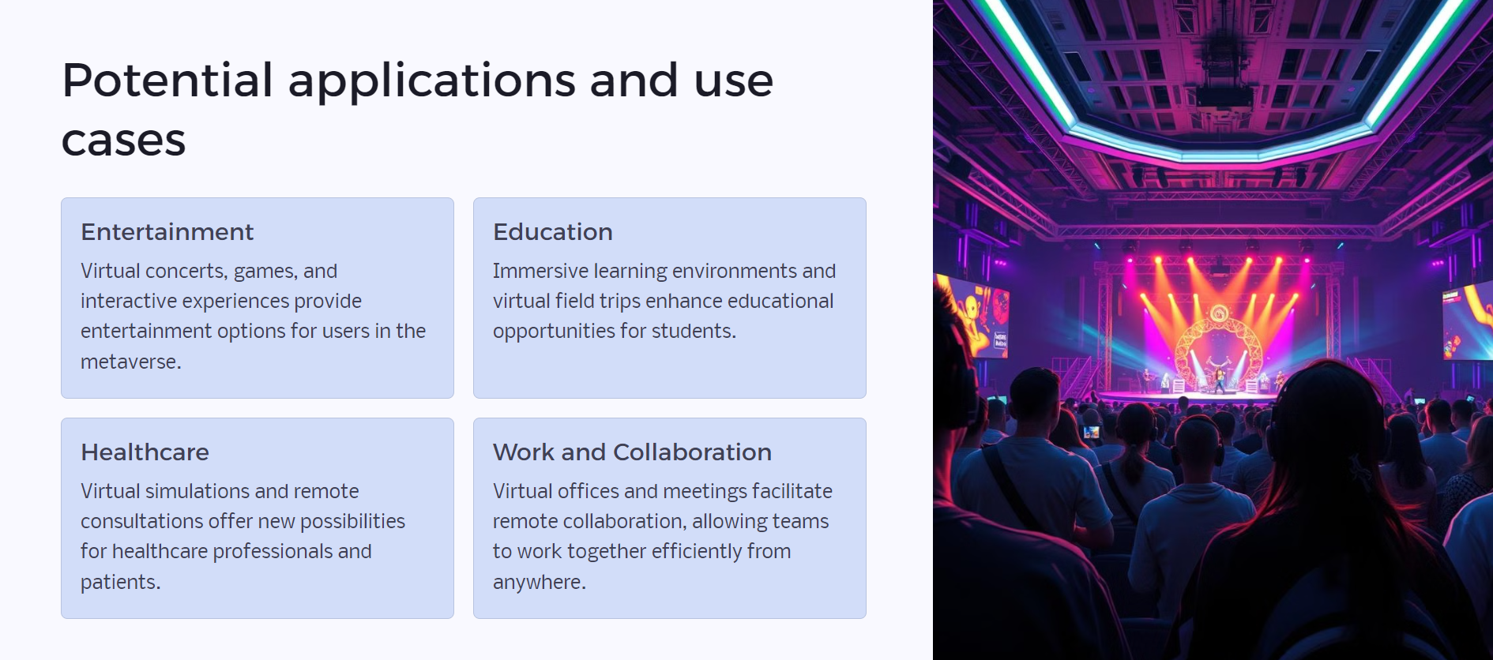

Slide 12

Challenges and Roadblocks Ahead
1
Technological Limitations
2
Security Risks
Security threats such as data breaches, cyberattacks, and fraud pose challenges to the metaverse.
The metaverse requires significant advancements in hardware, software, and infrastructure to become truly immersive and accessible.
3
Regulation and Governance
Developing clear regulations and ethical frameworks for the metaverse is crucial to ensuring its responsible development.

Slide 13
